Slide 1
Sim4IR Session A Speakers
Keynote
David Hawking
Paper Talks
Sebastian Günther
Yurou Zhao
Encore Talks
Claudia Hauff
Junqi Zhang
Manel Slokom

Slide 2
Sim4IR Session B Speakers
Keynote B
ChengXiang Zhai
Paper Talk
Pierre Erbacher
Encore Talks
Shuo Zhang
Ben Carterette
Jin Huang
Alexandre Salle
David Maxwell

Slide 3
Session A 0900-1230 CEST
The Simulation for Information Retrieval Workshop
Krisztian Balog, David Maxwell, Paul Thomas, Shuo Zhang
@krisztianbalog
@maxwelld90
@pt_ir
@imsure318
SIGIR 2021 Workshops (Online)
July 15th, 2021

Slide 4
Session B 1700-2040 CEST
The Simulation for Information Retrieval Workshop
Krisztian Balog, David Maxwell, Paul Thomas, Shuo Zhang
@krisztianbalog
@maxwelld90
@pt_ir
@imsure318
SIGIR 2021 Workshops (Online)
July 15th, 2021

Slide 5
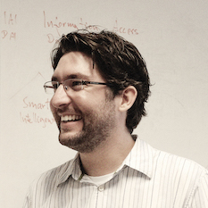
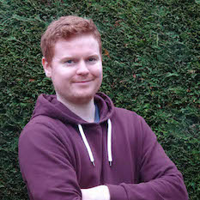
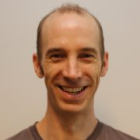
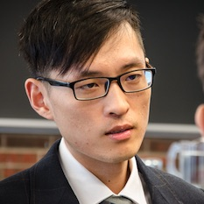
The Sim4IR Organisers
Krisztian Balog
David Maxwell
Paul Thomas
Shuo Zhang
Universitetet i Stavanger Norway
Technische Universiteit Delft The Netherlands
Microsoft Canberra Australia
Bloomberg AI London, England
@krisztianbalog
@maxwelld90
@pt_ir
@imsure318
Detailed workshop information available at https://sim4ir.org
2

Slide 6
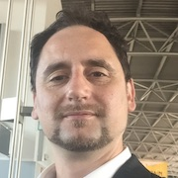
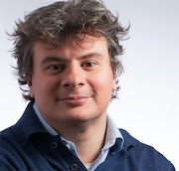
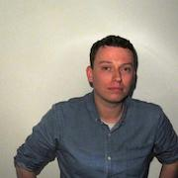
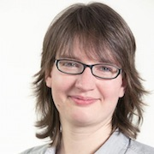
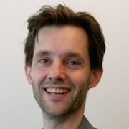


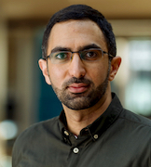
Thanks to the Sim4IR Reviewers!
Leif Azzopardi
Nicola Ferro
Christophe van Gysel
University of Strathclyde Scotland
Università delgi Studi di Padova Italy
Apple United States
Claudia Hauff
Djoerd Hiemstra
Janna Kekäläinen
Technische Universiteit Delft The Netherlands
Rabdoud Universiteit The Netherlands
Tampereen yliopisto Finland
Heikki Keskustalo
Mohamed Yahya
Tampereen yliopisto Finland
Bloomberg AI, London England
3

Slide 7
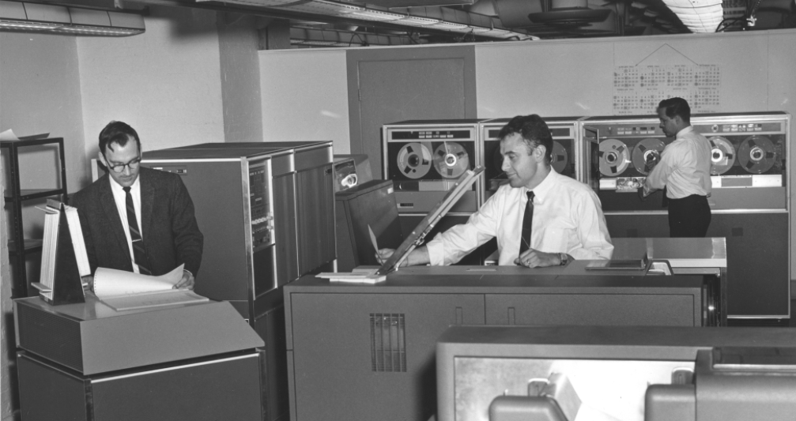
Simulation and Information Retrieval
Information Retrieval and simulation are no strangers!
We’ve been using simulation in IR-related work since the 1970’s…
Ranked Lists
User Interactions
Image: US Library of Congress
Search Sessions
Query Generation
1973
“A Simulation Model of an IR System”
Synthetic Data
4

Slide 8
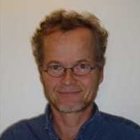
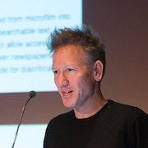
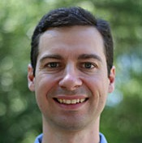
Where did we get to?
It’s been a while since we had a good think about simulation and IR…
SIGIR 2010 Workshop on the Simulation of Interaction
Leif Azzopardi
Kalervo
Järvelin
Jaap Kamps
Mark Smucker
ACM SIGIR Forum 44, 2, pp. 35-47
doi.org/10.1145/1924475.1924484
5

Slide 9
Where are we now?
Let’s have a think about where we are as a community when it comes to simulation – and how recent developments could make use of it!
Reinforcement
Learning
Conversational IR
Mature Technologies
6

Slide 10
Sim4IR Workshop Structure
Split over two sessions to cater for an international audience
A + B
1
1
5
+
Icons – thenounproject.com
Keynote
Presentation
Paper Presentation
“Encore” Presentations
Breakout Discussions
7

Slide 11
Session A Schedule
0900 CEST
1230 CEST
0915
0950
0950
1030
1040
1125
1125
1230 (ish)
Keynote A
David Hawking
Paper Talks
Sebastian Günther
Yurou Zhao
Encore Talks
Claudia Hauff
Junqi Zhang
Manel Slokom
Breakout
Discussion & Reporting
Detailed information (in your timezone!) at https://sim4ir.org/schedule
6

Slide 12
Session B Schedule
1700 CEST
2040 CEST
1715
1750
1750
1810
1820
1935
1945
2040 (ish)
Keynote B
ChengXiang Zhai
Paper Talk
Pierre Erbacher
Encore Talks
Shuo Zhang
Ben Carterette
Jin Huang
Alexandre Salle
David Maxwell
Breakout
Discussion & Reporting
Detailed information (in your timezone!) at https://sim4ir.org/schedule
9

Slide 13
Synthetic Data Generation
There’s been a long history of building test collections/corpora.
In the 1970’s, researchers had access to miniscule volumes of data
Researchers like Cooper (1973) generated synthetic data for evaluating their library search systems…
This line of work has been developed over the years...
…which leads nicely to our first keynote speaker!
8

Slide 14
Considering User Modelling
Click Behaviours
Interactions
with Systems
Querying Behaviours
Relevance Models
8

Slide 15
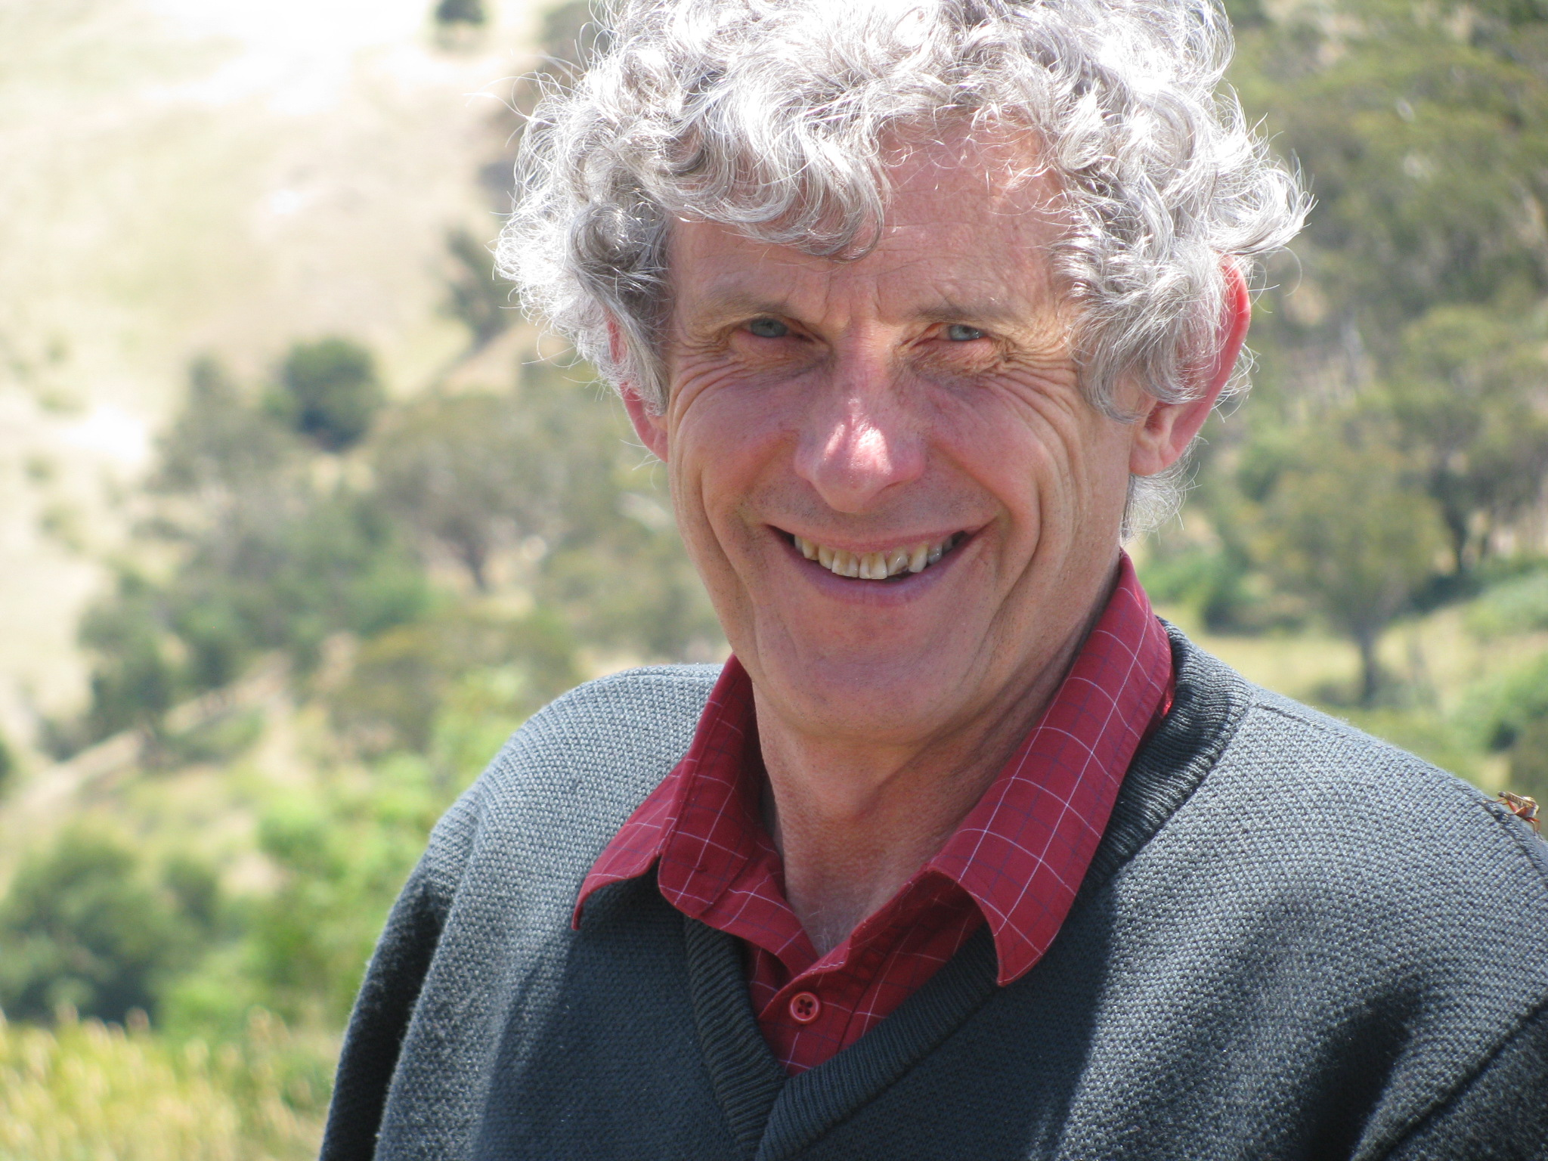
Keynote A
How Useful are Results from Simulated Test Collections?
David Hawking
Honorary Professor, Australian National University
9

Slide 16
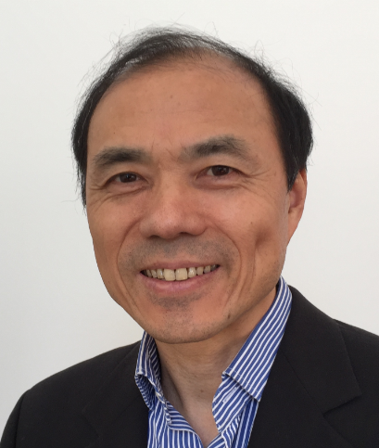
Keynote B
User Simulation for Information Retrieval Evaluation: Opportunities and Challenges
ChengXiang Zhai
Professor, University of Illinois at Urbana-Champaign
ACM SIGIR Salton Award Winner, 2021
9

